Slide 1
Joe Antony
Antimicrobial Activity

Slide 2
Sample Code: Joe 2

Slide 3
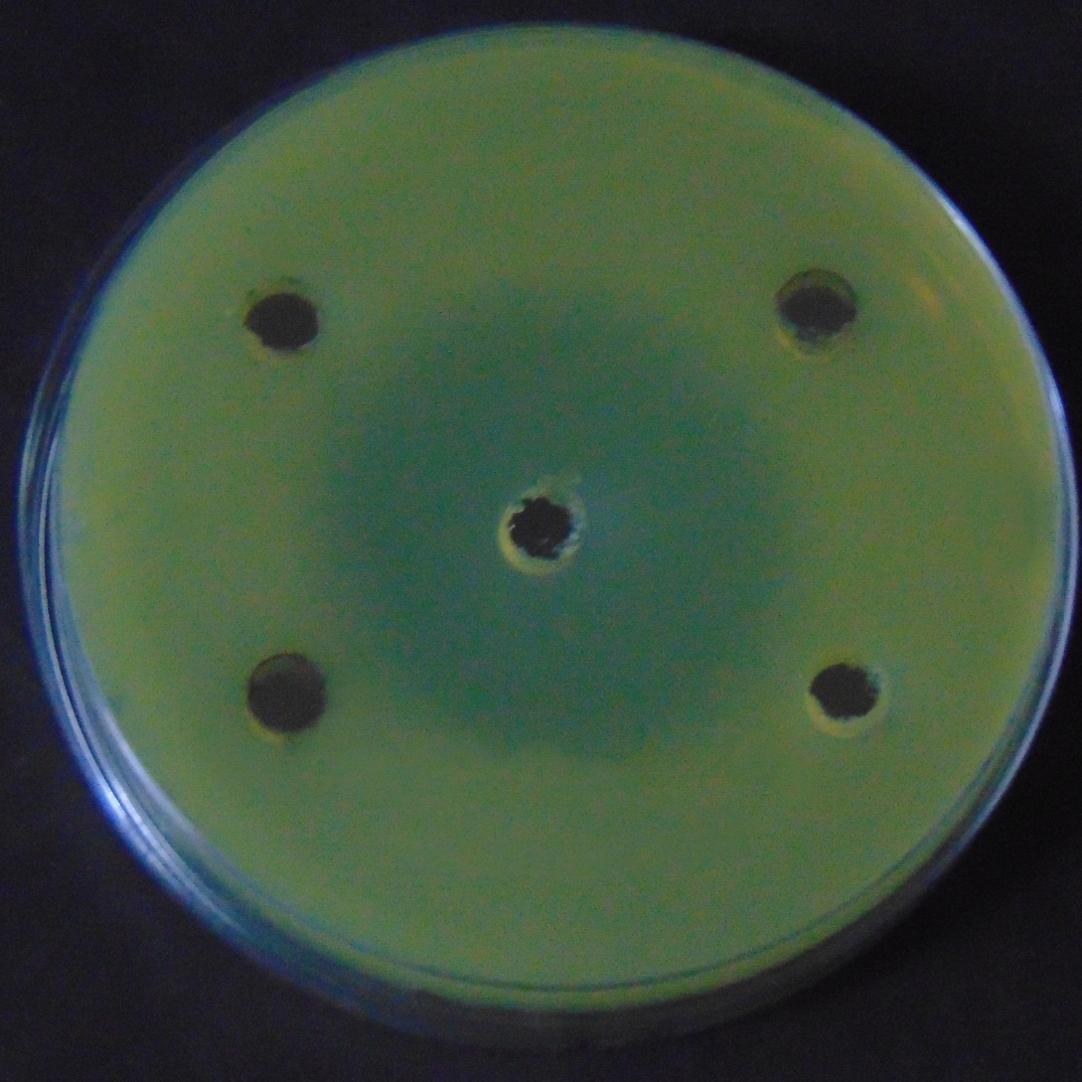
100 µg/ml
250µg/ml
500 µg/ml
+Ve Control
-ve
Control
E.coli

Slide 4
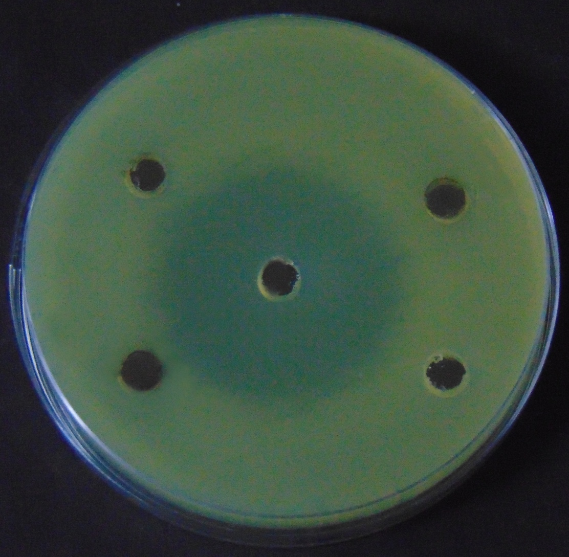
100 µg/ml
250 µg/ml
500 µg/ml
+Ve Control
-ve
Control
E.coli

Slide 5
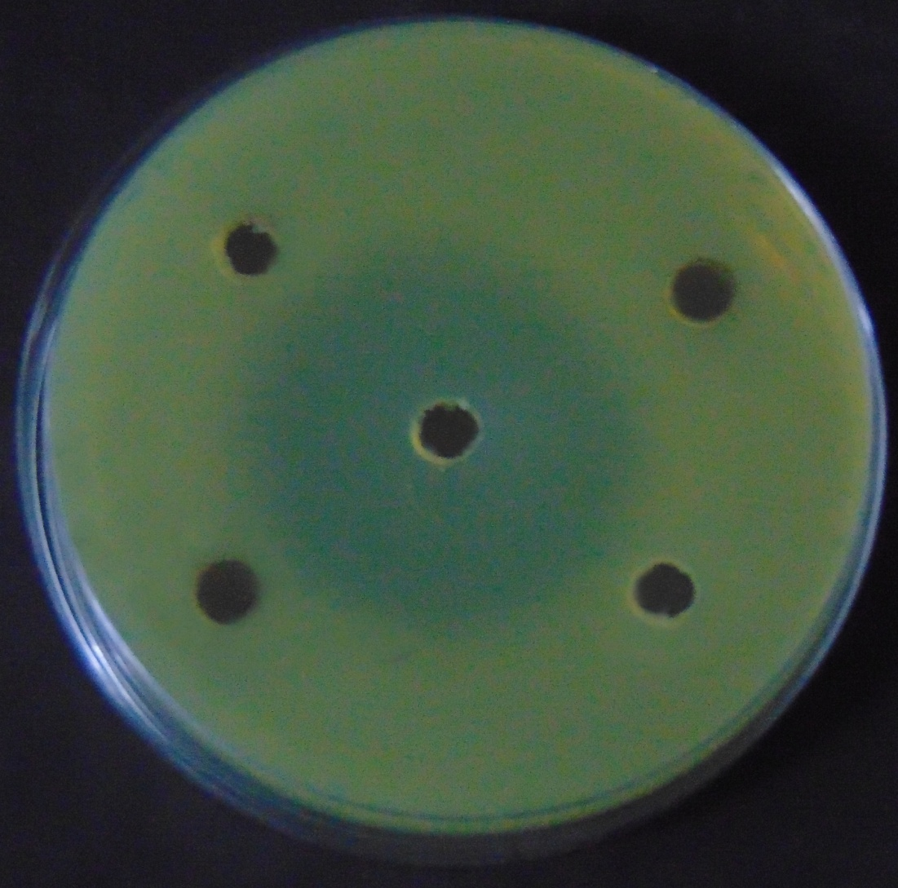
100 µg/ml
250 µg/ml
500 µg/ml
+Ve Control
-ve
Control
E.coli

Slide 6
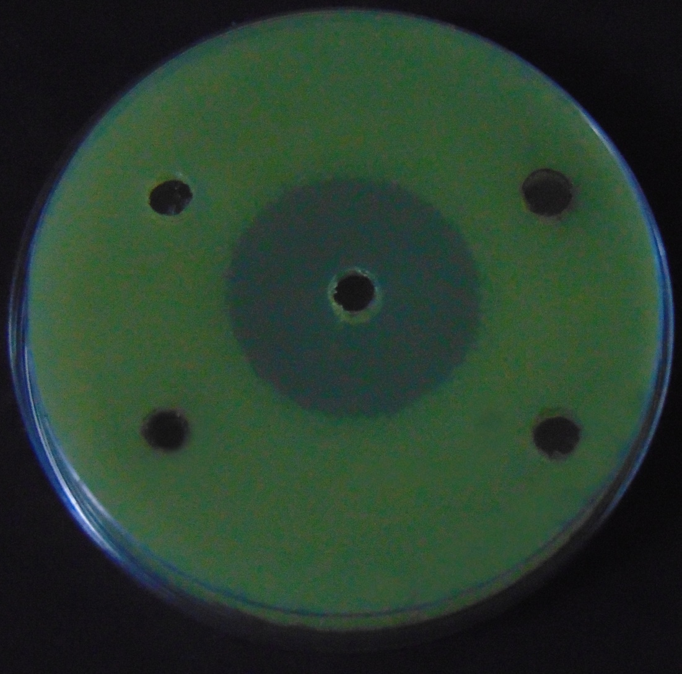
100 µg/ml
250µg/ml
+Ve Control
500 µg/ml
-ve
Control
E.lenta

Slide 7
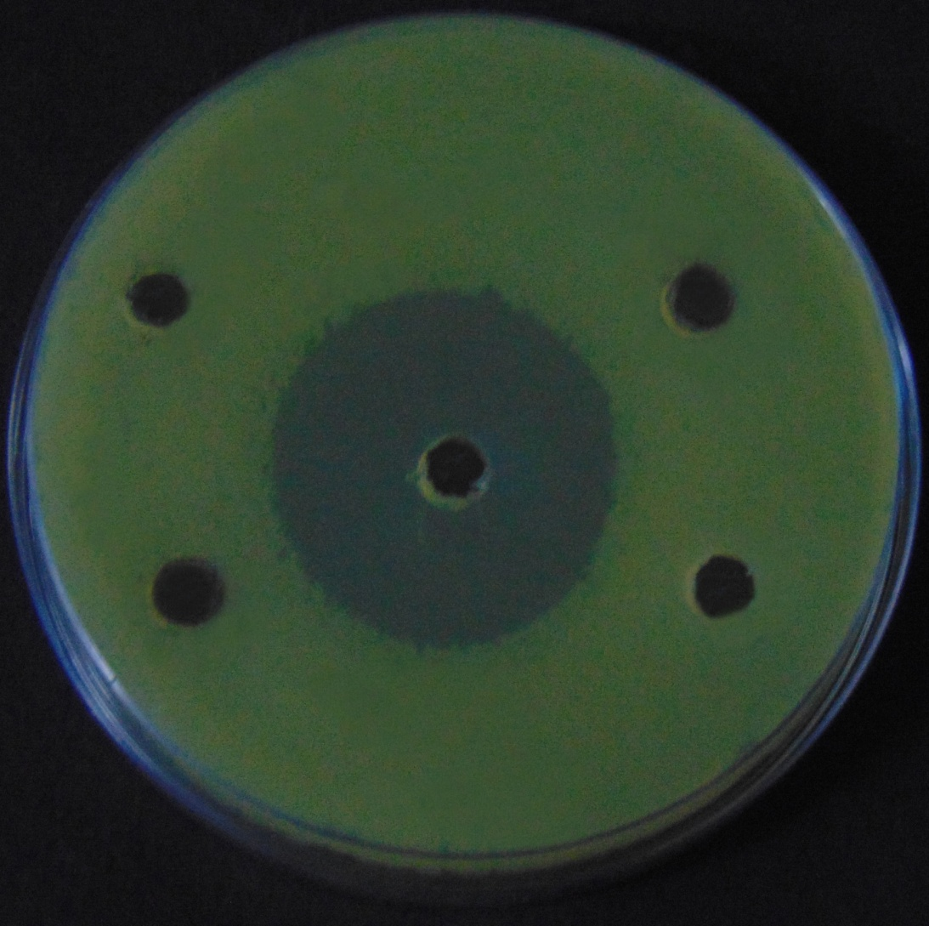
100 µg/ml
250 µg/ml
500 µg/ml
-ve
Control
+Ve Control
E.lenta

Slide 8
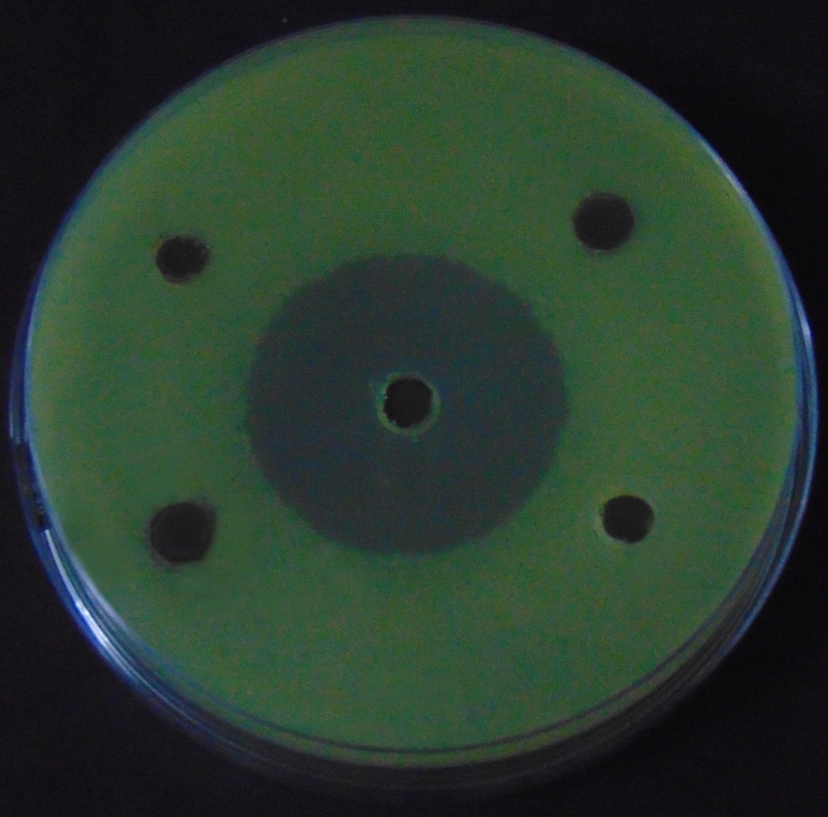
100 µg/ml
250 µg/ml
-ve
Control
500 µg/ml
+Ve Control
E.lenta

